Slide 1
The Transition Academy System
Team name: BISTU
Team member: Peihao Fang 16269402
Hao Zhang 16269394
Ziqing Chen 16268899

Slide 2

Homepage
On our homepage, we present user a clear operation interface with direct illustration about our mission.

Slide 3
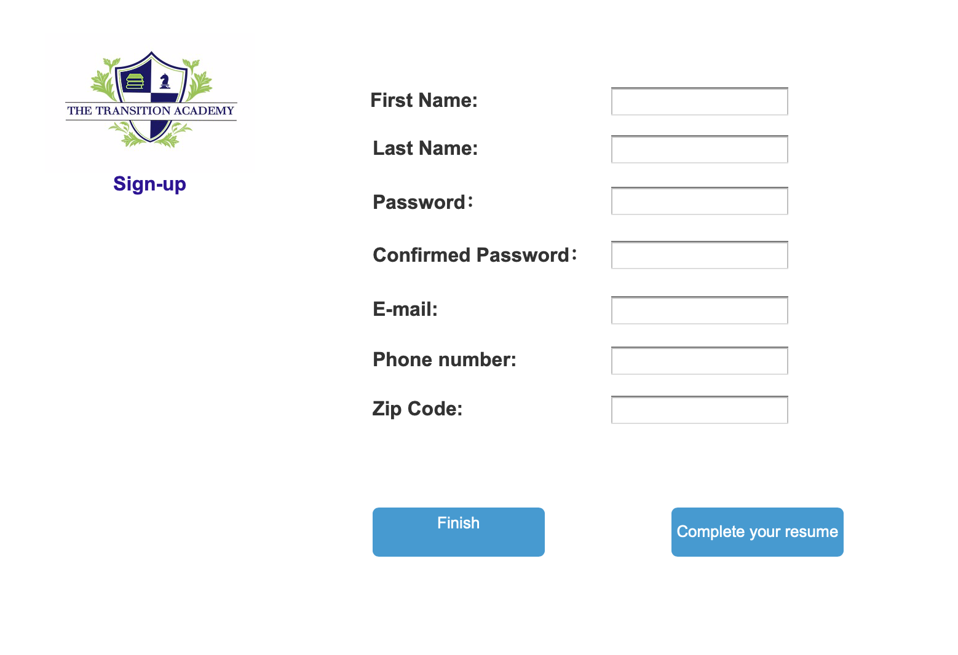
We design a basic sign-up page for user to register their information

Slide 4
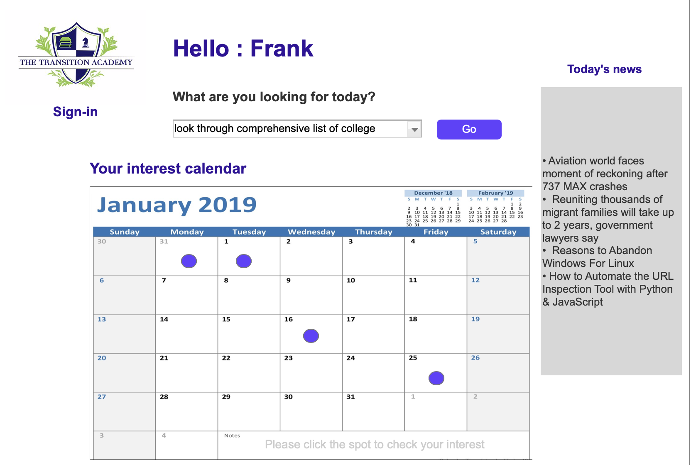
The sign-in page we offer user a personal calendar to record their personal activities and a directory (drop box) to which filed you are looking for today . And you will redirect to the relevant page.

Slide 5
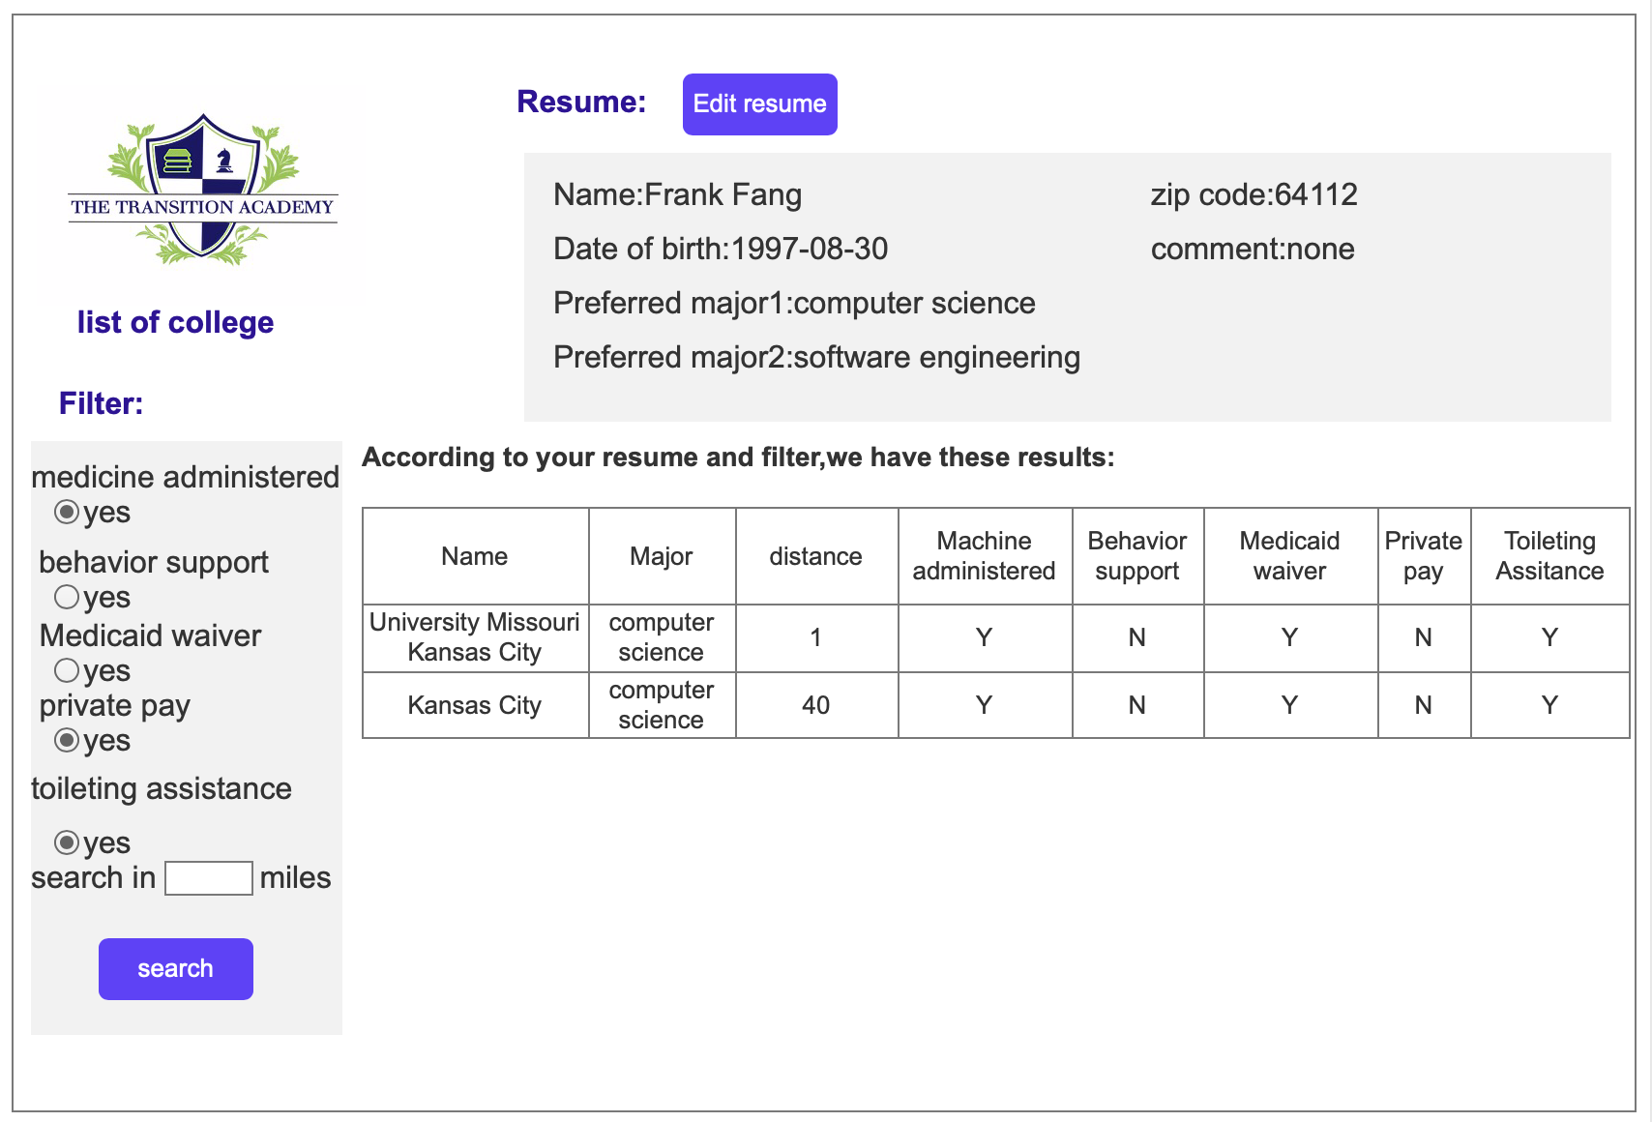
A brief look to user’s resume , they can edit by the button
Filter
For user, user can extract the result which they are interested in
The most suitable result for user after extraction by filter.

Slide 6
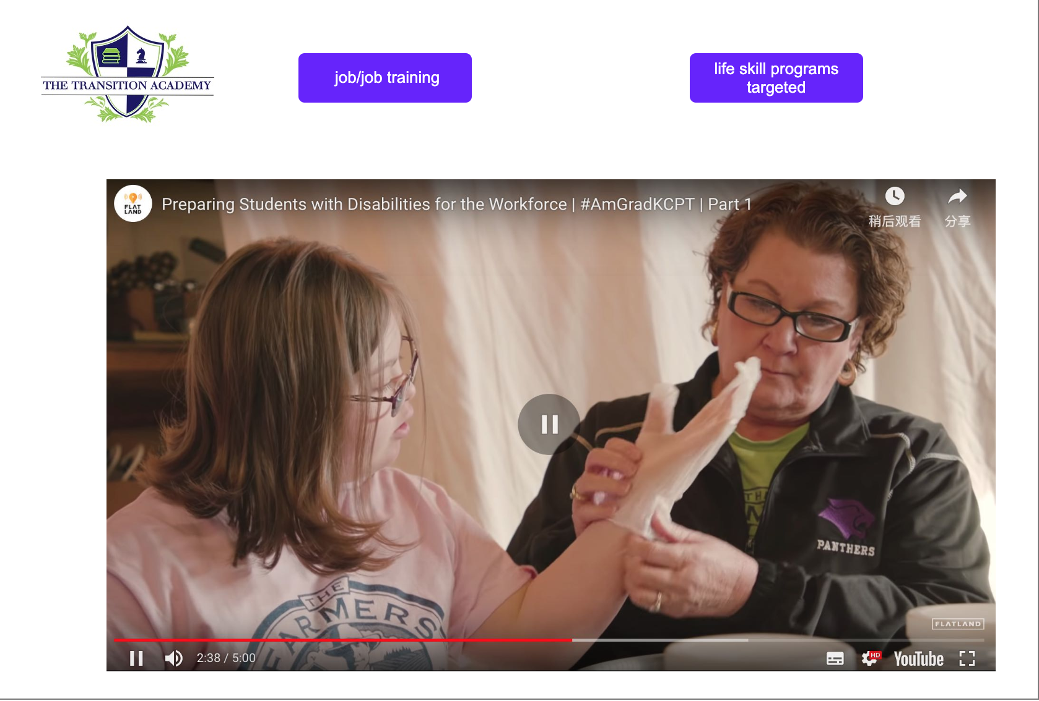
You can choose which you want to go in this website.

Slide 7
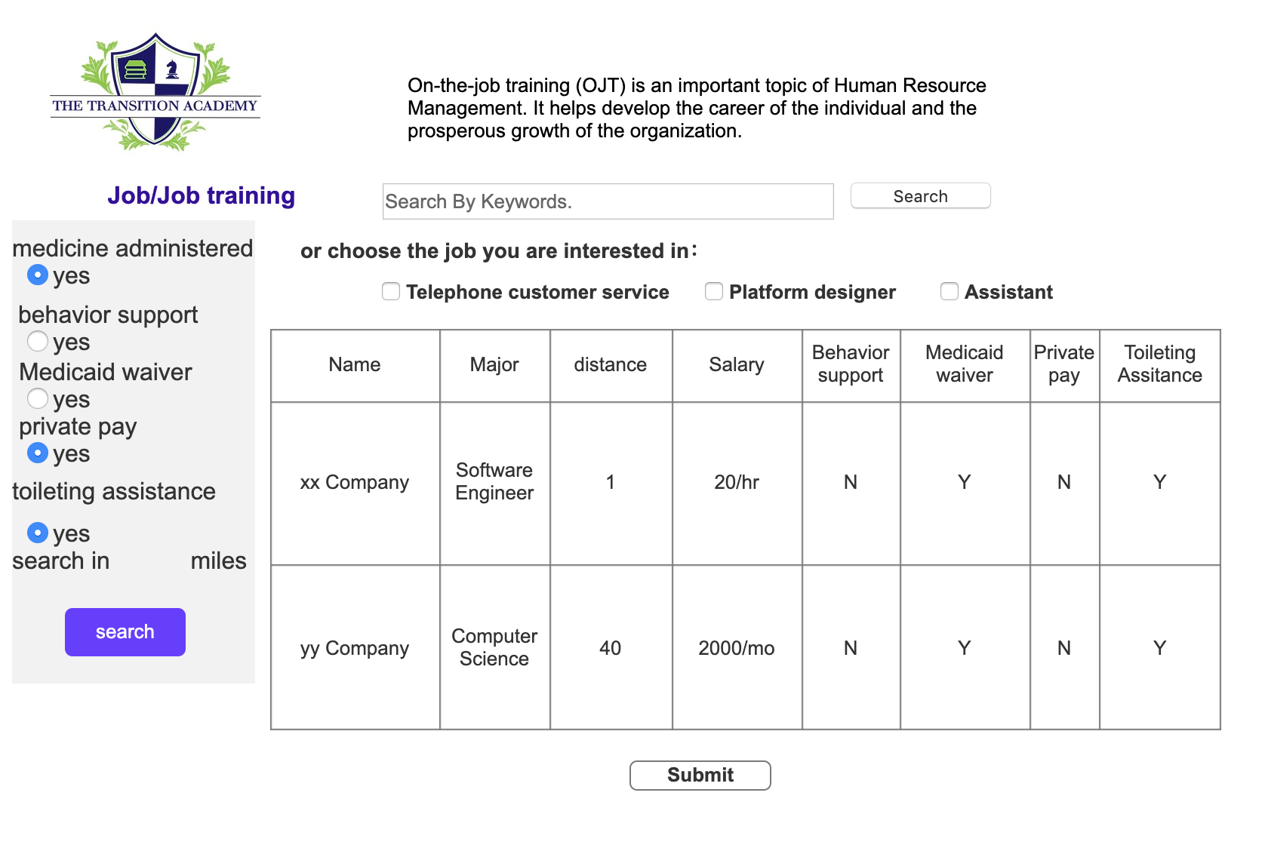
This page is for job and job training. You can search keywords and filter what you want.

Slide 8
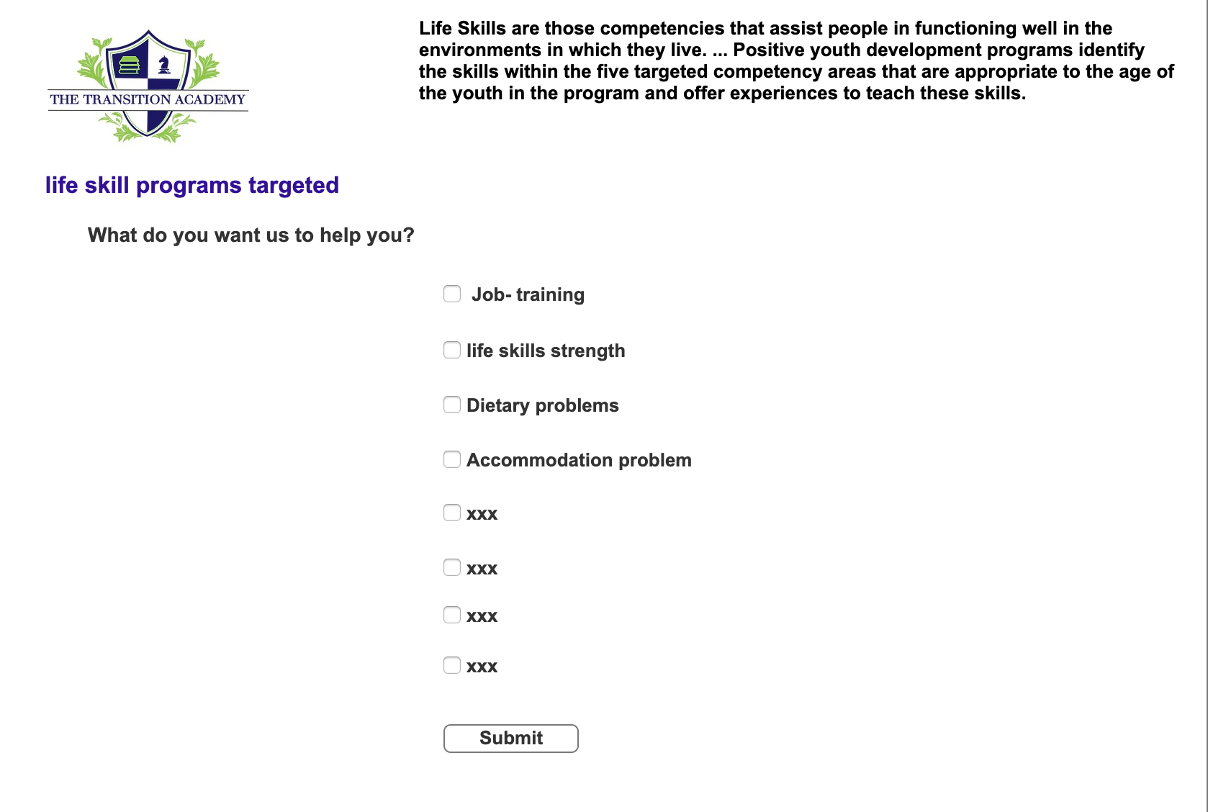
This page is for life skill programs. In case if you have something consideration.

Slide 9
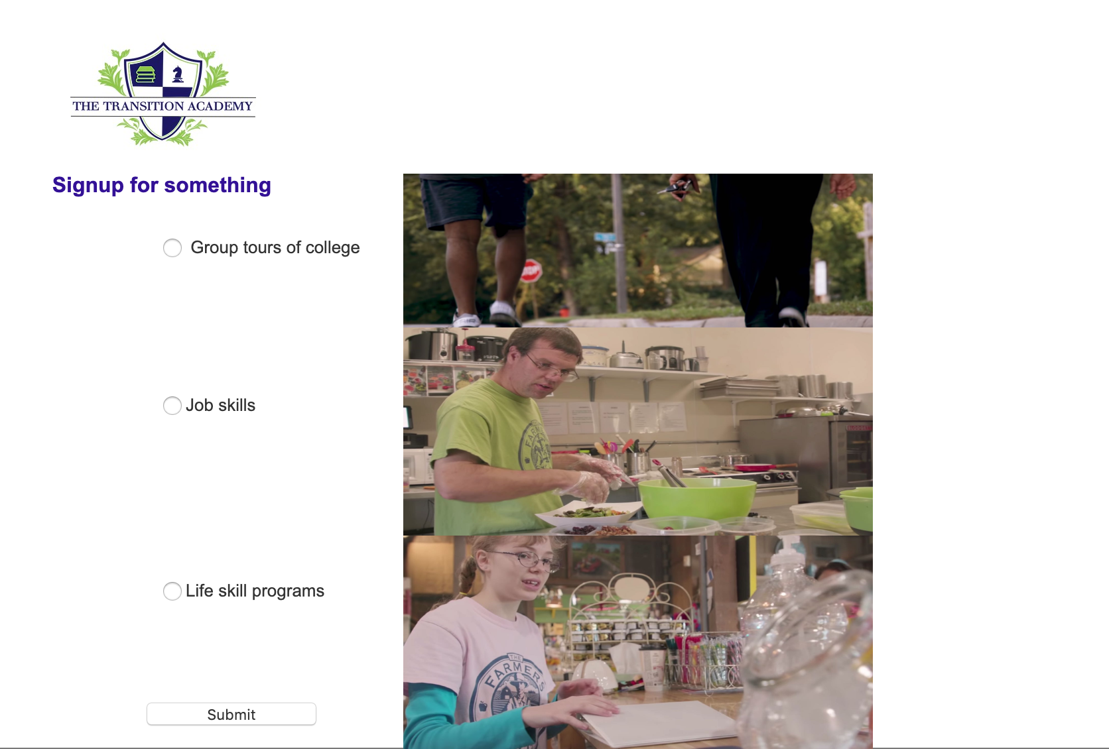
sign up for group tours of college, job and life skill programs.

Slide 11
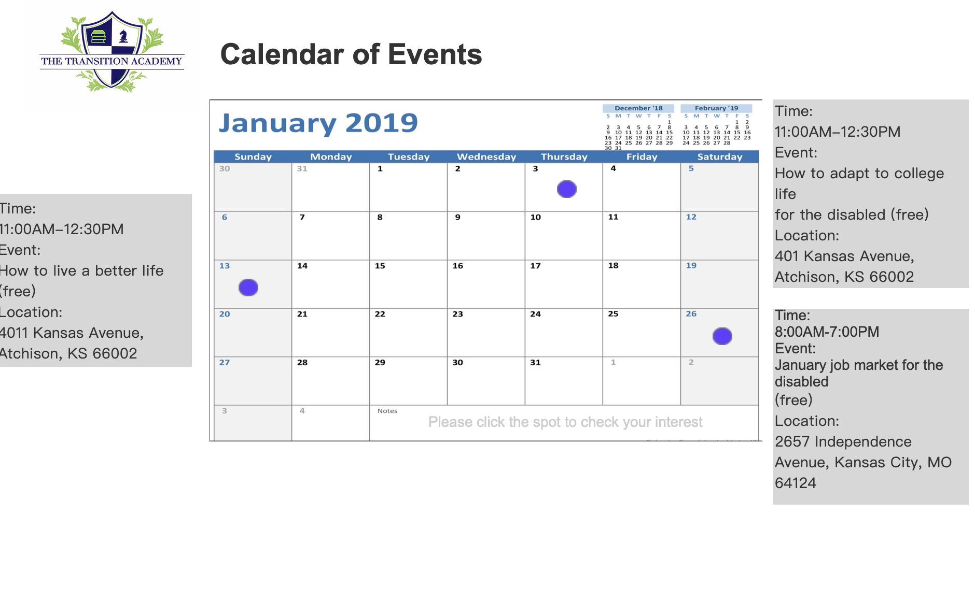
This page is the calendar of events. You can see all the events of this month. If you want to know more about the event, you can click the purple circle, and then the website will show the time, event topic, and the location. It is very convenient.

